Slide 1
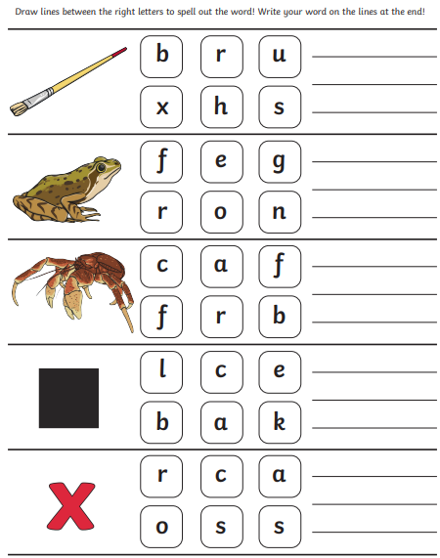
Phonics

Slide 2
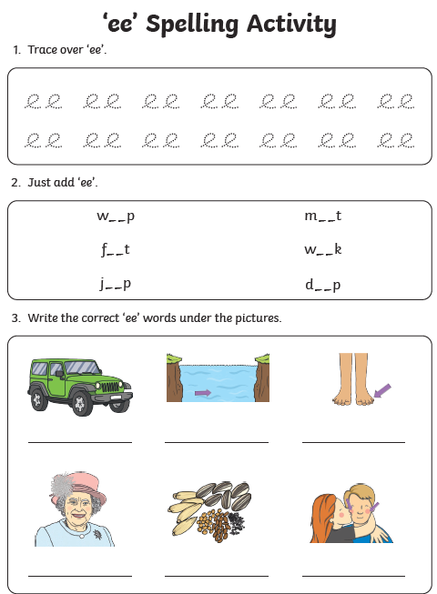
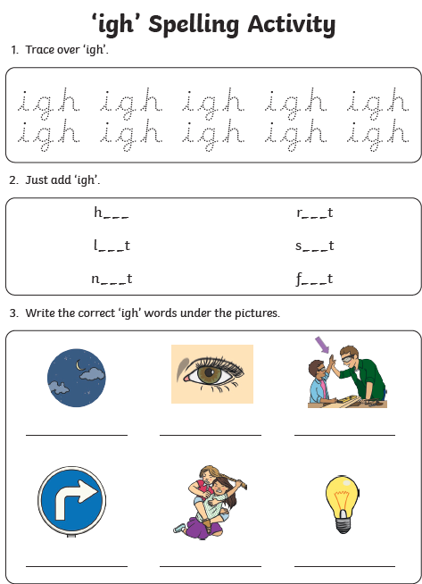

Slide 3
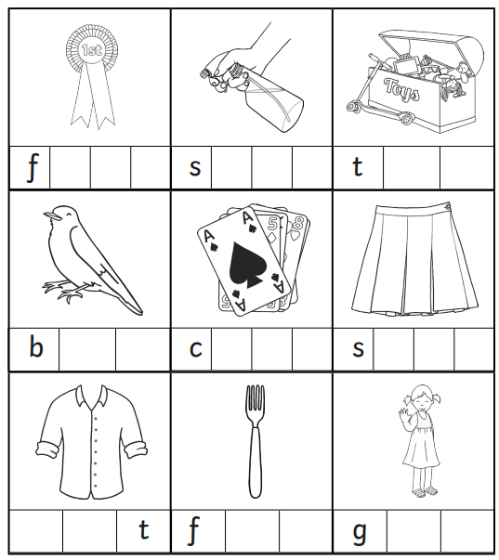

Slide 4
Comprehension – Where the Wild Things Are Monday 2nd December 2024

Slide 5
Focus Text

Slide 6
Focus Text

Slide 7
Focus Text

Slide 8
Focus Text

Slide 9
Focus Text

Slide 10
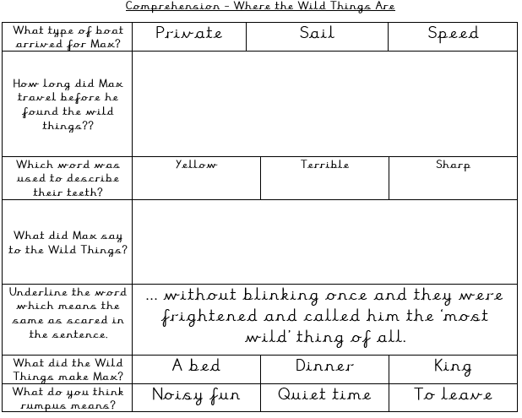

Slide 11
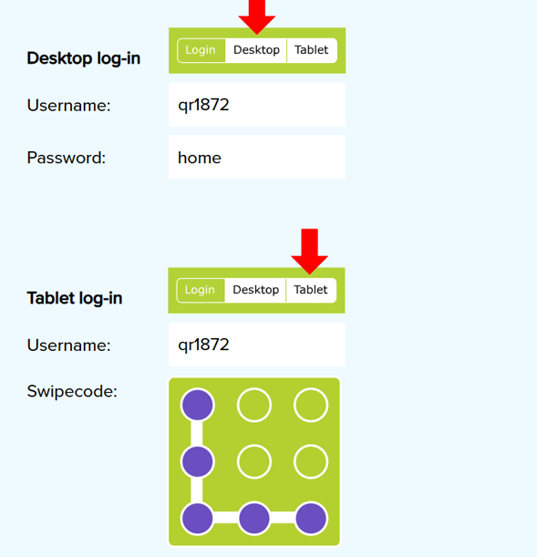

Slide 12
Maths

Slide 13
Tuesday 3rd December 2024 03.12.24
Maths
School closure
Learning Title - Consolidation

Slide 14
Either build or draw this problem out to help find the answer.

Slide 15
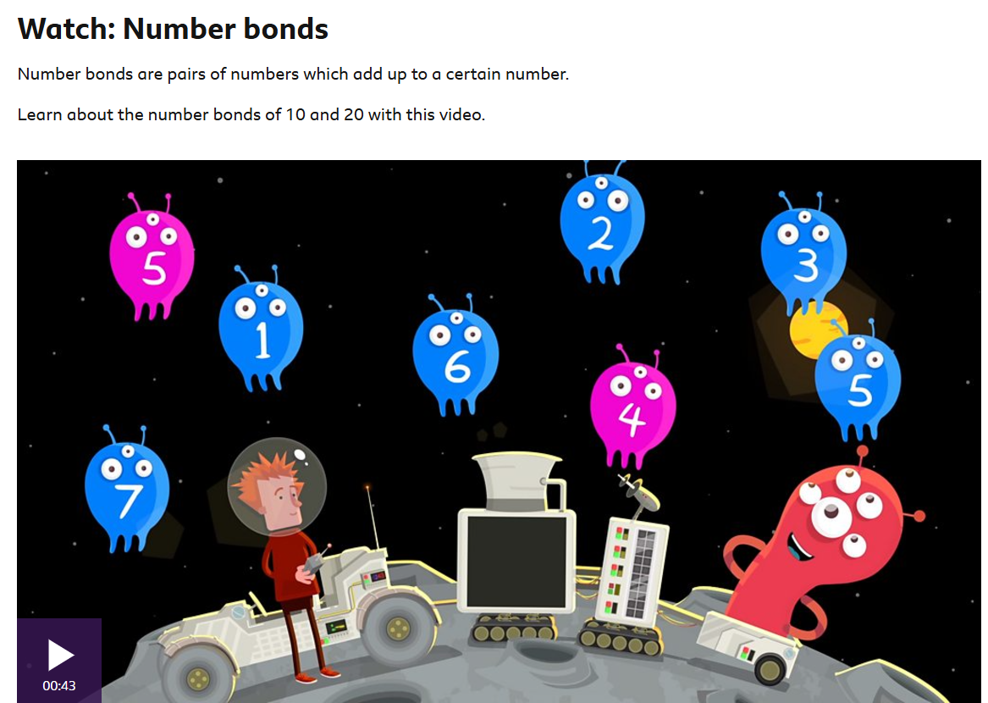
https://www.bbc.co.uk/bitesize/topics/z22cmbk/articles/zx3982p
Explore the bitesize website
Watch videos, take a quiz and play games linked to our learning.

Slide 16
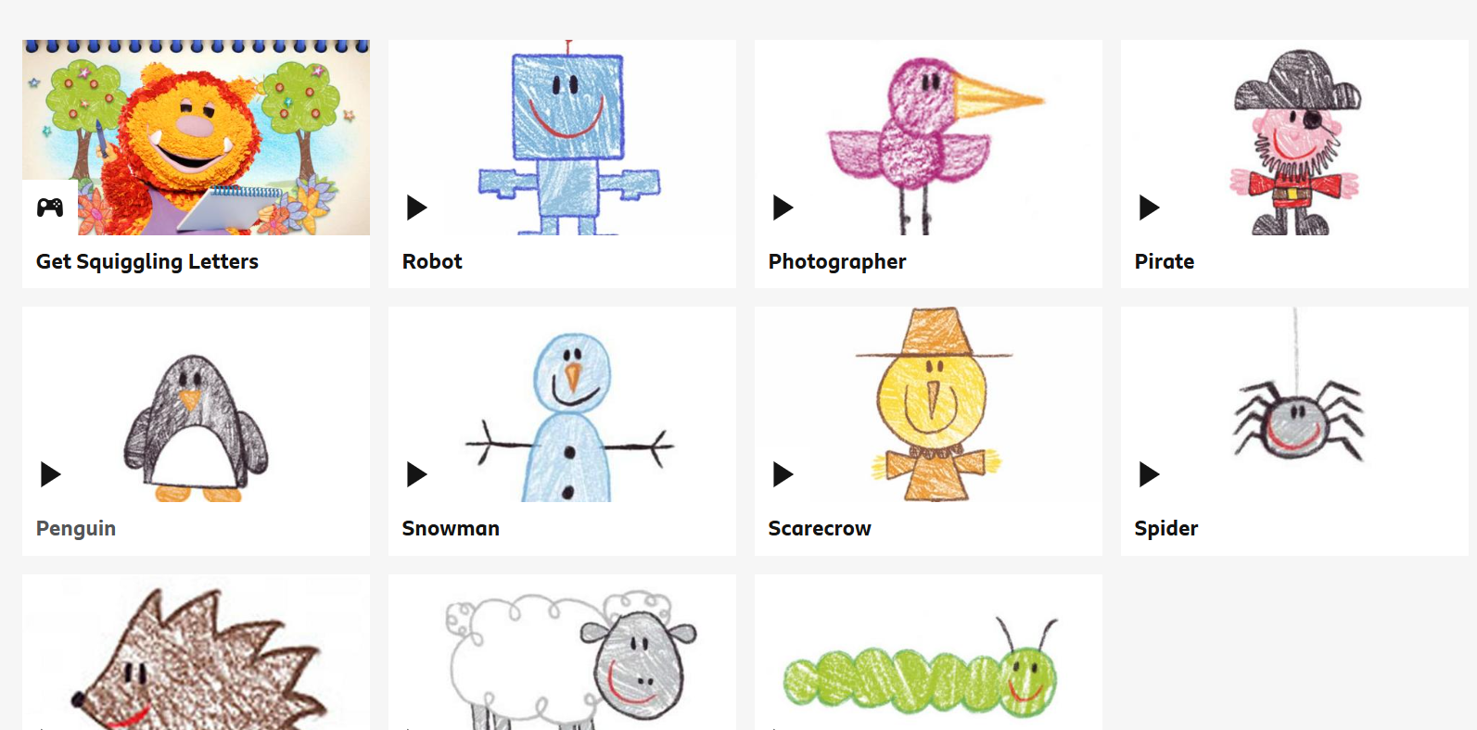
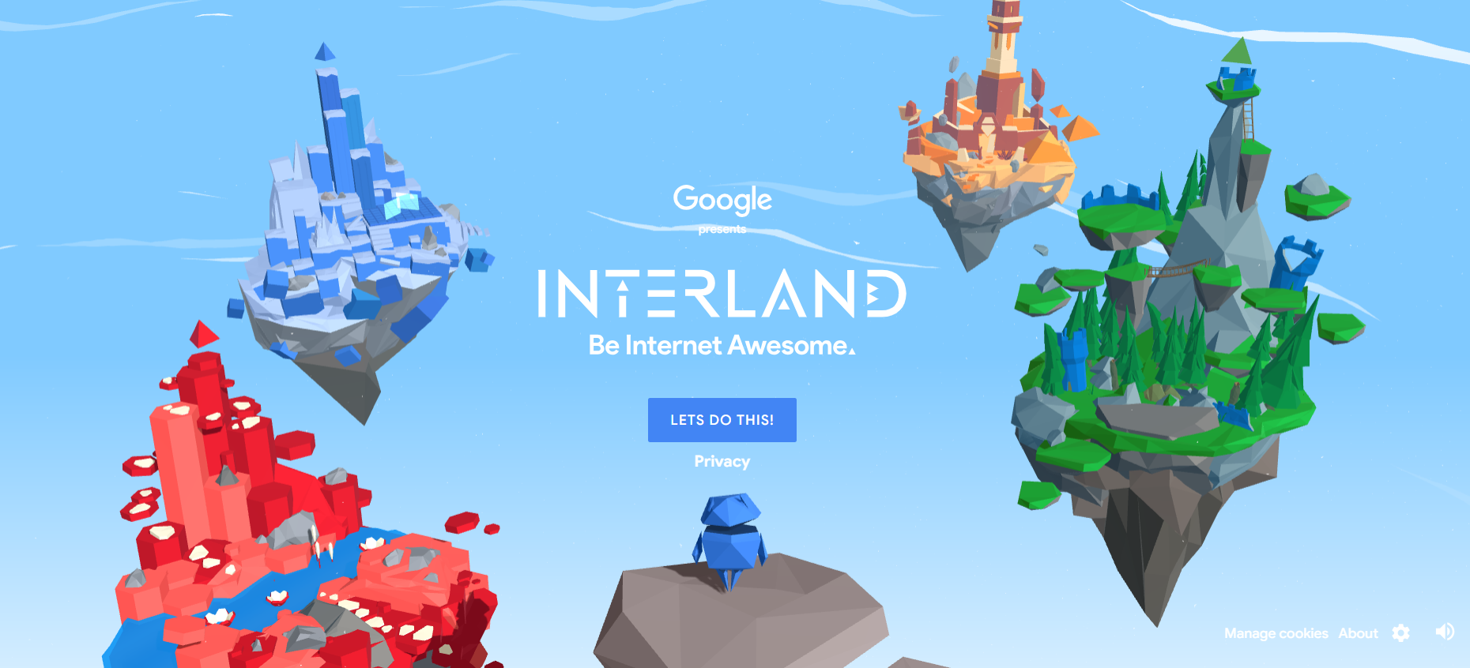
Head back to the website for links to carious educational games.

