Slide 1
My Phonics Workbook

Slide 2
Dear Parents/Carers,
Easter Homework Pack
Let your children practise their phonics by reading the sounds and words listed in this pack. Repeated practice helps your child’s learning, so encourage them to practice the pack over and over again!
Little and often works best, 2 activities each day is plenty of practice.
Sounds: Each comes with a picture and a rhyme to help children remember it – Scan the QR code to access the Read Write Inc. virtual classroom for each sound.
Special friends: A sound made up of one or more letters.
The words: Single syllable, multi-syllabic and nonsense ‘alien’ words (these help build children’s reading stamina).
The children read the word using this routine:
Special friends, Fred-Talk, Read the word.
Thank you for your support with your child’s reading journey. Please speak with you child’s class teacher if you have any questions.

Slide 3
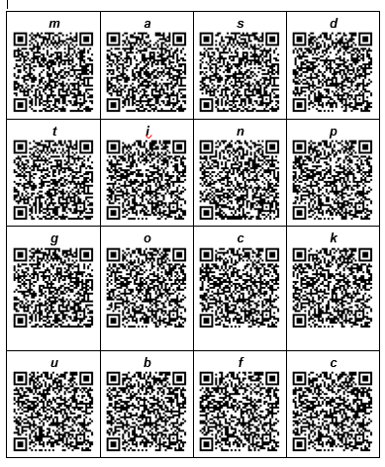
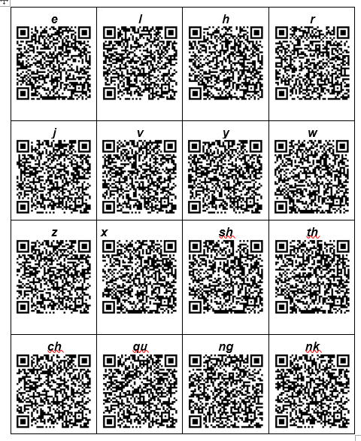
Individual Letters

Slide 4
Special friends

Slide 5
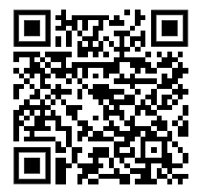
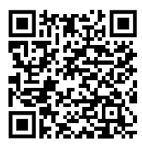
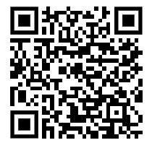
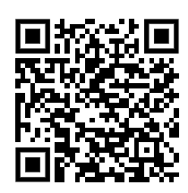
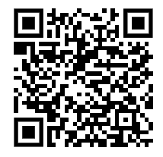
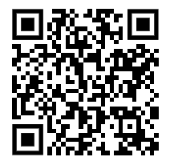
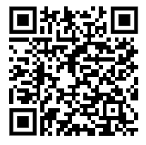
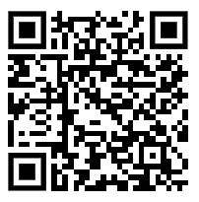
Reading words

