Slide 1
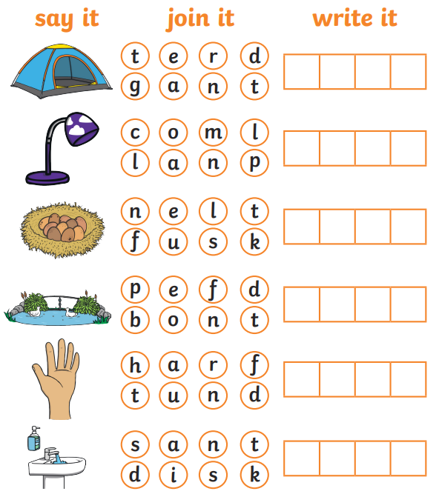
Phonics

Slide 2
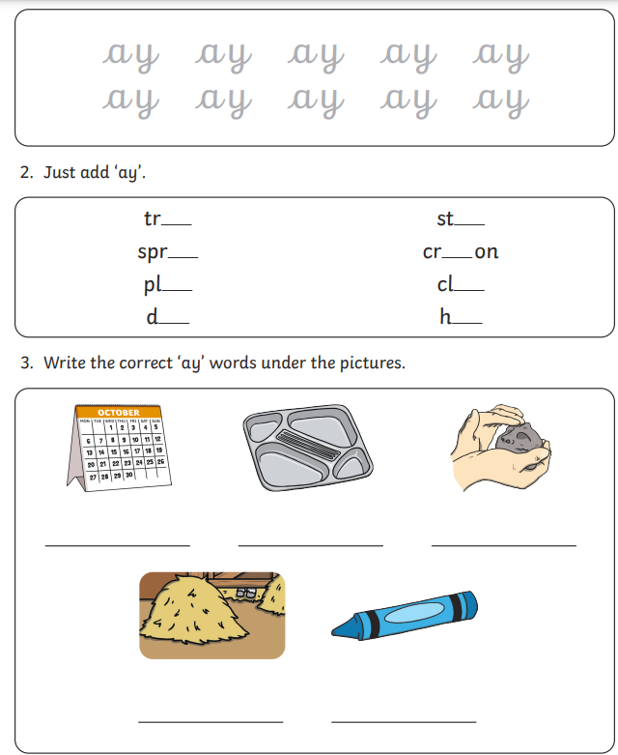
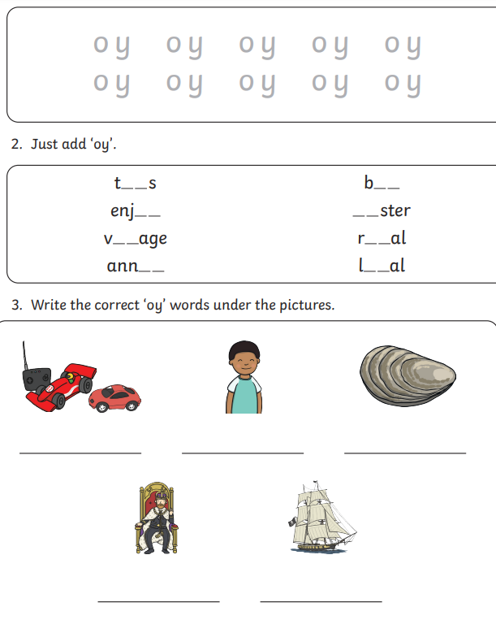

Slide 3
Comprehension – Where the Wild Things Are Monday 2nd December 2024

Slide 4
Focus Text

Slide 5
Focus Text

Slide 6
Focus Text

Slide 7
Focus Text

Slide 8
Focus Text

Slide 9
Focus Text

Slide 10
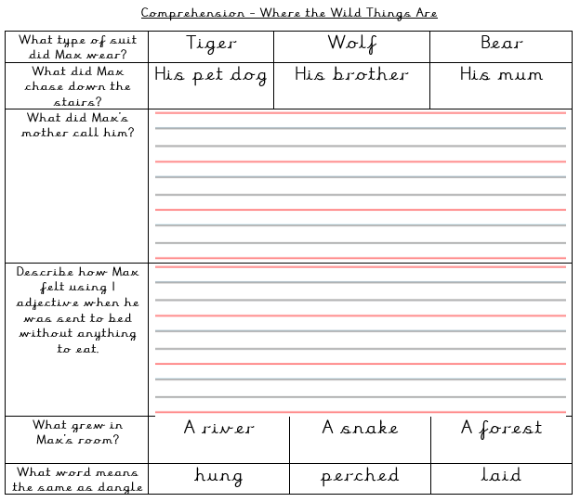

Slide 11
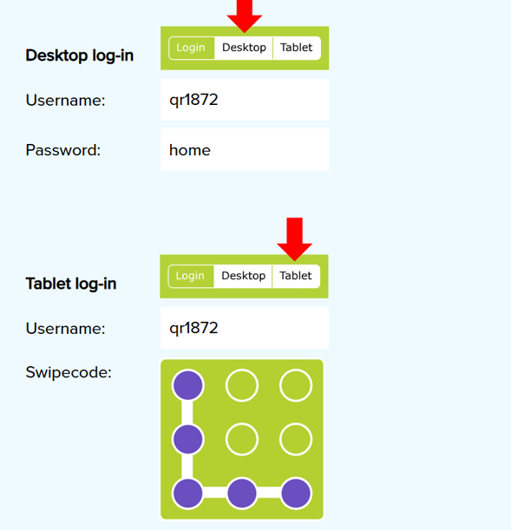

Slide 12
Maths

Slide 13
Monday 2nd December 2024 02.12.24
Maths
School closure
Learning Title - Consolidation

Slide 25
