Slide 1


Slide 3




How many beanbags can you see?
5

Slide 4


___ is a part and ___ is a part.
How many beanbags land inside?
How many land outside?
3
2
The whole is ___
5

Slide 5

___ is a part and ___ is a part.
How many beanbags land inside?
How many land outside?
1
4
The whole is ___
5

Slide 6

___ is a part and ___ is a part.
How many beanbags land inside?
How many land outside?
2
3
The whole is ___
5

Slide 7
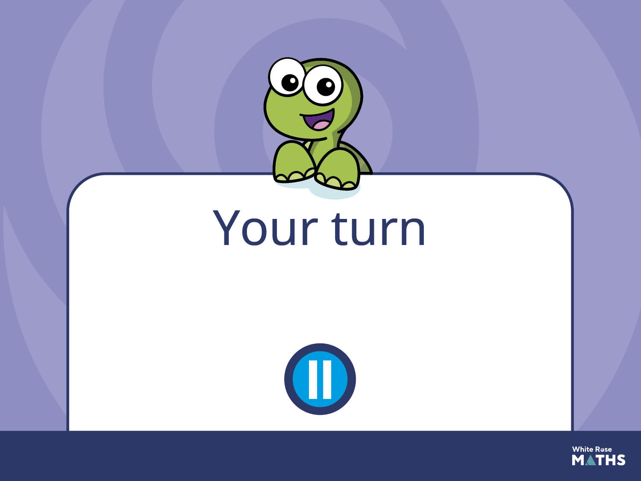
Have a go at the next activity.

Slide 8
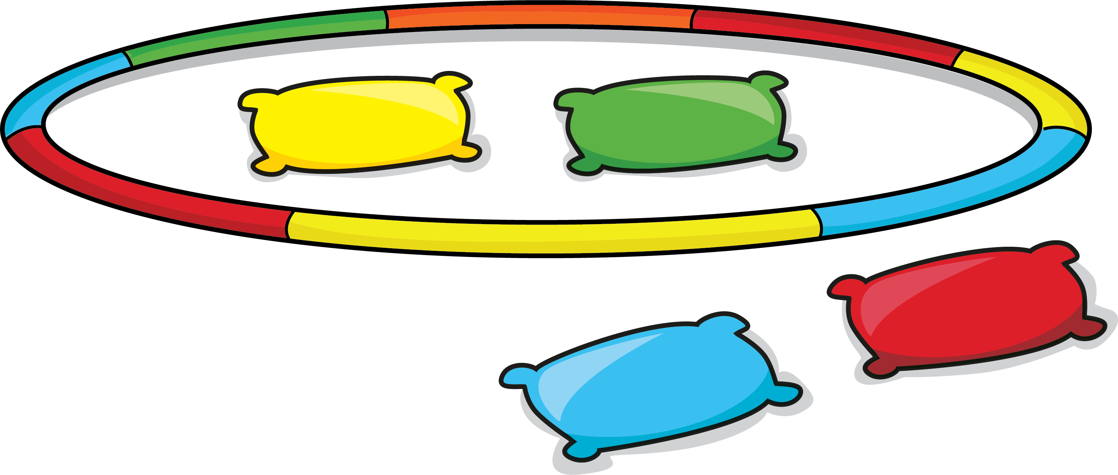
Explore composition of numbers 1-5 using beanbags and a hoop.
Ask children to talk about the whole and the parts they can see.
Repeat with different numbers.

